Slide 1

ABDELGHAFOR’S
HACKATHON
M A C H I N E L E A R N I N G H A C K A T H O N
Telecom Customer Churn
Prediction and Segmentation

Slide 2



Team Members
Asmaa Khaled Khorkhash
Amir Tarek Ali
Merna hatem abdelfatah
Member
Member
Member

Slide 3
Introduction
Our project aims to analyze customer behavior in the telecom industry to predict and reduce customer churn. Churn is a significant issue for telecom companies, as losing customers impacts revenue and market share. By implementing machine learning techniques, we intend to develop predictive models that help identify at-risk customers and propose strategies to improve customer retention.

Slide 4

Problem Solution
Dataset Overview:
We are using a telecom dataset that includes customer details like demographics, service usage, contract types, and payment methods. This data will help us understand customer behavior, predict who might churn, and group customers into segments. Before applying machine learning models, we'll clean and prepare the data to ensure accurate results

Slide 5

Expected Outcomes
Improved Customer Experience:
Gain insights into customer satisfaction, leading to enhanced service offerings and reduced churn
Churn Prediction
Identify customers likely to leave the service, allowing for targeted retention strategies.
Operational Insights:
Understand service usage patterns that correlate with churn, enabling better resource allocation and service enhancements.

Slide 6
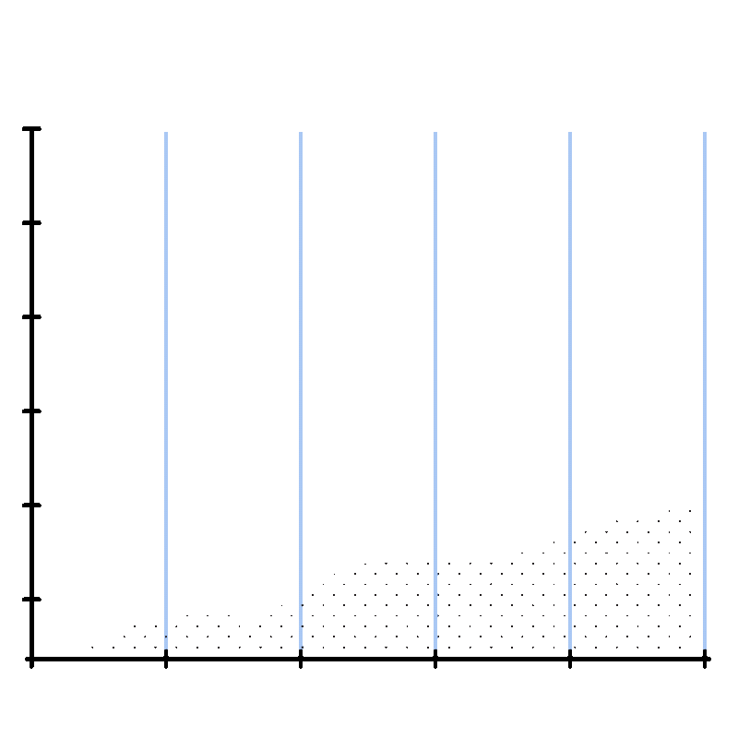


Tools & Techniques
Data Preprocessing
Visualization Tools:
Machine Learning Models
Used Pandas to load the dataset efficiently from a CSV file.
Utilized Pandas for handling missing values, encoding categorical features, and ensuring data quality for analysis.
We used Python libraries like Matplotlib, Seaborn and Plotly Express to create visualizations that help us explore the data and present insights clearly.
RandomForestClassifier
Logistic Regression
DecisionTreeClassifier
XGBoost Classifier
SVC
GaussianNB

Slide 7

Data Preprocessing
1.Handling Missing Values and duplicated data:
3. Categorical Encoding:
We used two methods to convert categorical data:
Label Encoding for: 'PhoneService', 'gender', 'Partner', 'Dependents', 'PaperlessBilling', and 'Churn'.
One-Hot Encoding for: 'PaymentMethod', 'MultipleLines', 'InternetService', 'OnlineSecurity', 'OnlineBackup', 'DeviceProtection', 'TechSupport', 'StreamingTV', 'StreamingMovies', and 'Contract'.
"We checked the dataset for duplicates and removed them. We also looked for any missing values and handled them by either removing incomplete records or filling in the gaps."
2. Outlier Detection:
We examined the data for outliers, which could distort model performance, and decided whether to remove or transform these values to improve accuracy.
4. Feature Engineering:
We created New feature ‘Eligibleforservice’ .This feature identifies customers eligible to subscribe to our service based on their internet service types.

Slide 8
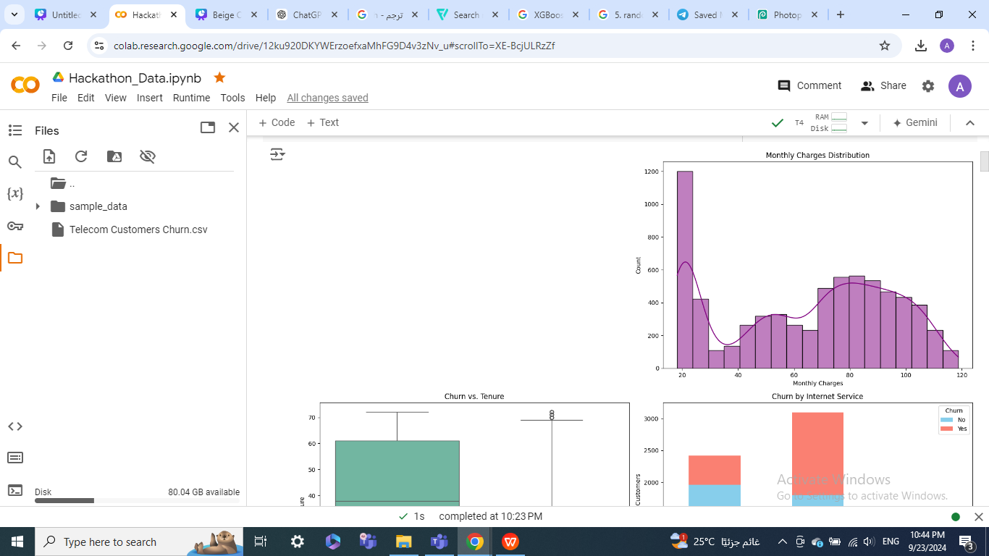
Data Visualization
Monthly Charges Distribution (Histogram)
This histogram illustrates the distribution of monthly charges among customers. The inclusion of a kernel density estimate (KDE) curve helps smooth the distribution and highlight the underlying trends. The chart helps us identify any skewness in the charges and potential outliers.

Slide 9
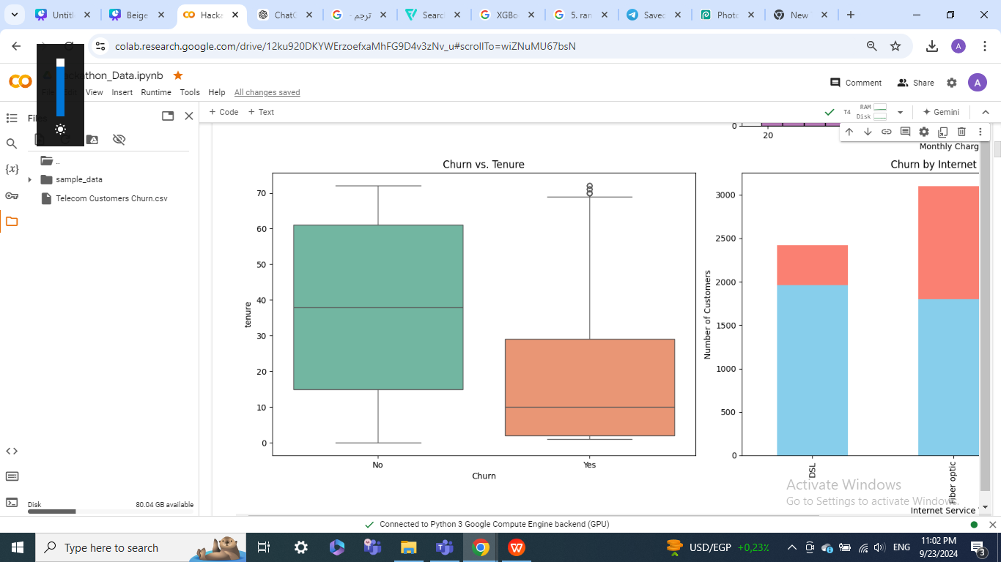
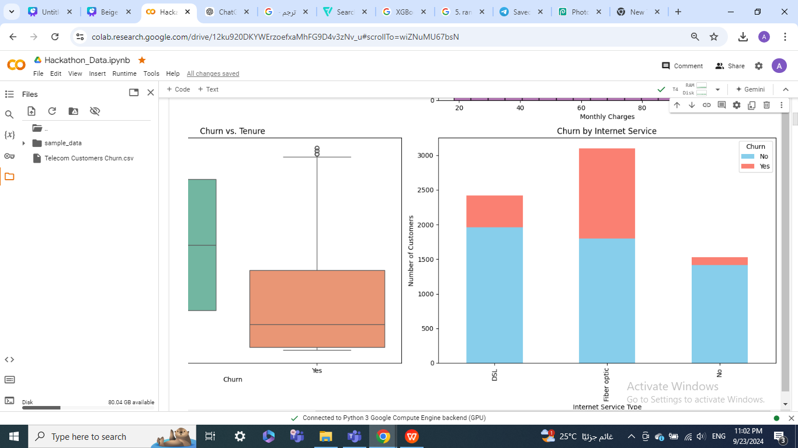
Data Visualization
Churn Analysis and Correlations
The boxplot compares customer tenure between those who churned and those who didn't, revealing any potential tenure-related churn patterns. The bar plot, comparing churn rates by Internet service type, highlights whether specific services lead to higher churn rates, offering actionable insights for targeted service improvements.

Slide 10
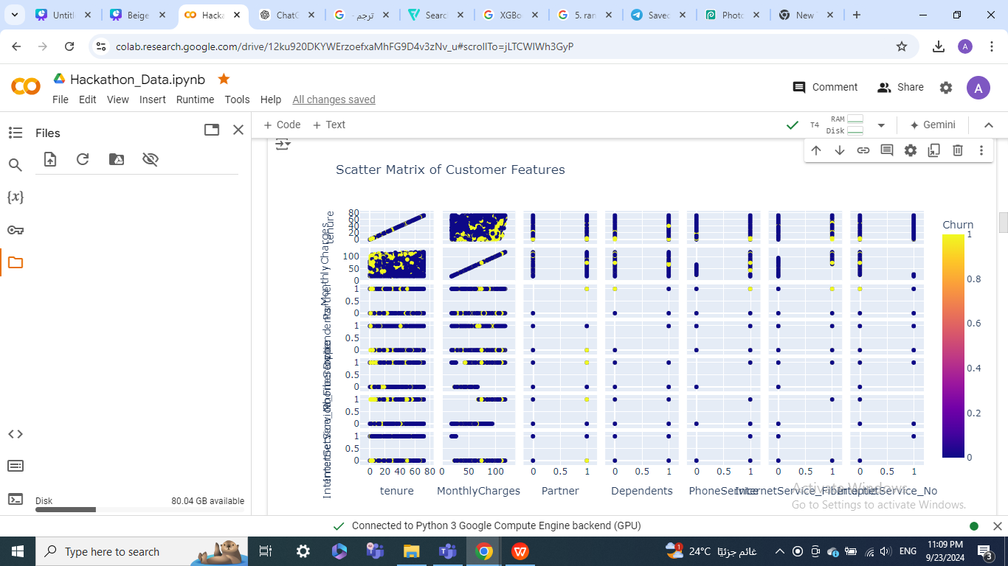
Data Visualization
Scatter Matrix of Customer Features and Churn Correlations
We selected key features like tenure, monthly charges, and Internet service types, including one-hot encoded columns. A scatter matrix plot was created to show relationships between these features, with churn status highlighted by color. This helps us spot potential patterns before modeling

Slide 11
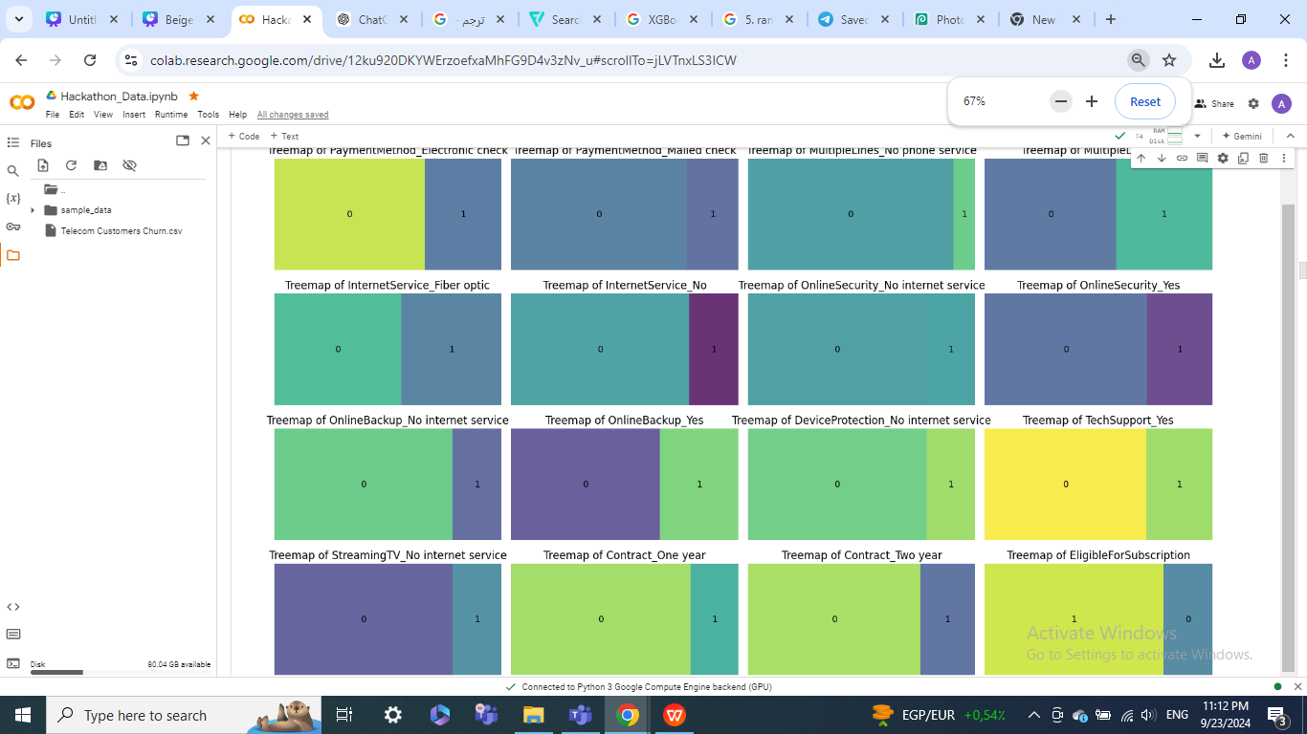
Data Visualization
Treemaps of Categorical Feature Distributions
We created treemaps for all categorical variables to visualize the distribution of each category. Each treemap shows the proportion of different values within a variable, helping to quickly identify dominant categories. This was done for multiple features in the dataset, offering an overview of their composition

Slide 12
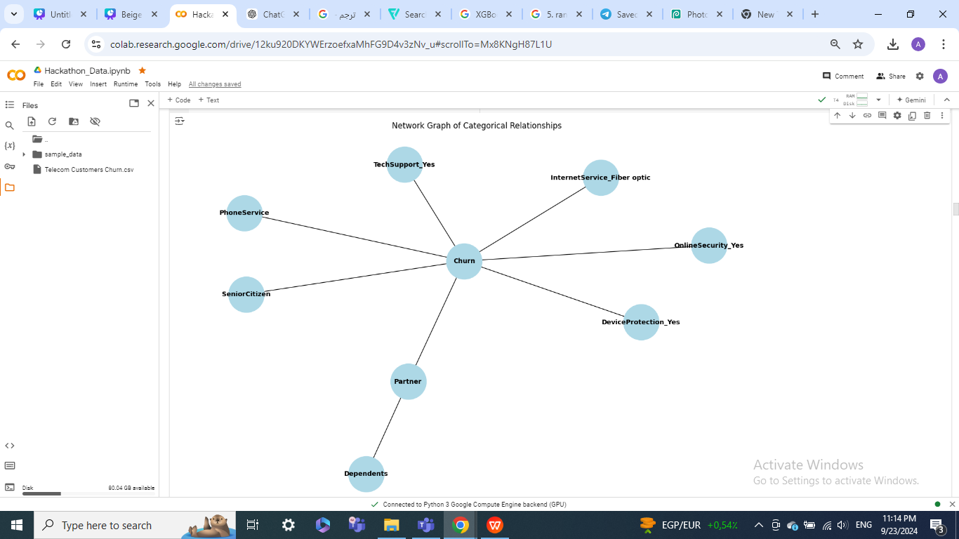
Data Visualization
Network Graph of Categorical Relationships
We constructed a network graph to display relationships between key categorical features, such as Partner status, Senior Citizen, and various services. The connections highlight how these features relate to customer churn, providing a clear visual representation of categorical dependencies and interactions in the dataset

Slide 13
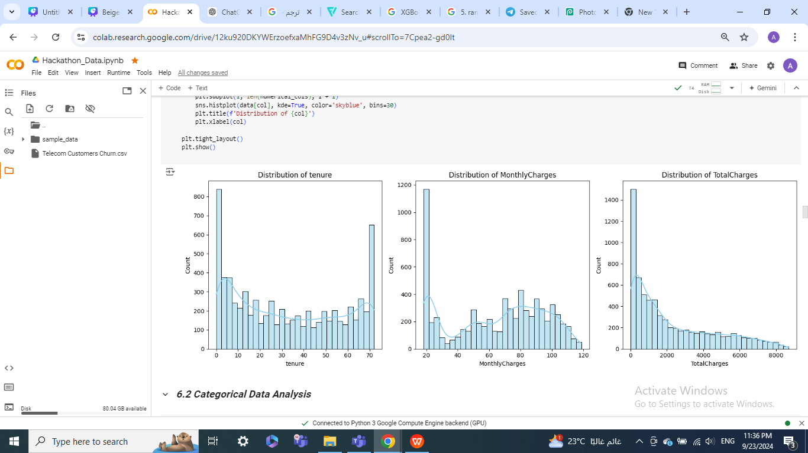
Data Exploratory analysis (EDA)
1. Univariate Analysis
purpose: Explore the distribution of individual variables.
Insights: Provided an understanding of each feature's distribution, such as customer tenure, monthly charges, and churn rates.

Slide 14
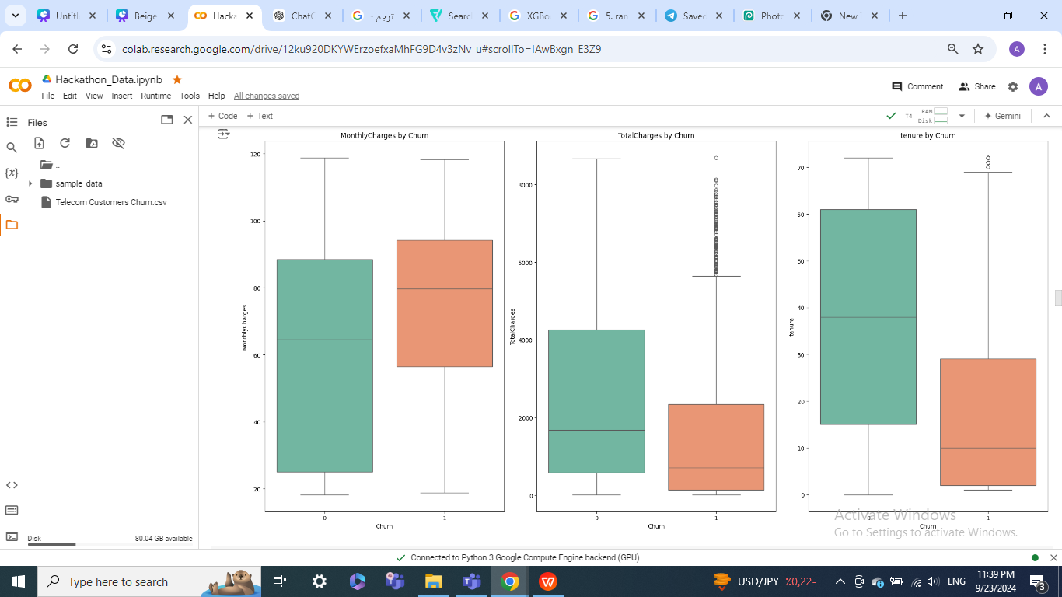
Data Exploratory analysis (EDA)
2. Bivariate Analysis
Purpose: Understand relationships between two variables.
Insights: Helped uncover key patterns, like customers with shorter tenure were more likely to churn.

Slide 15
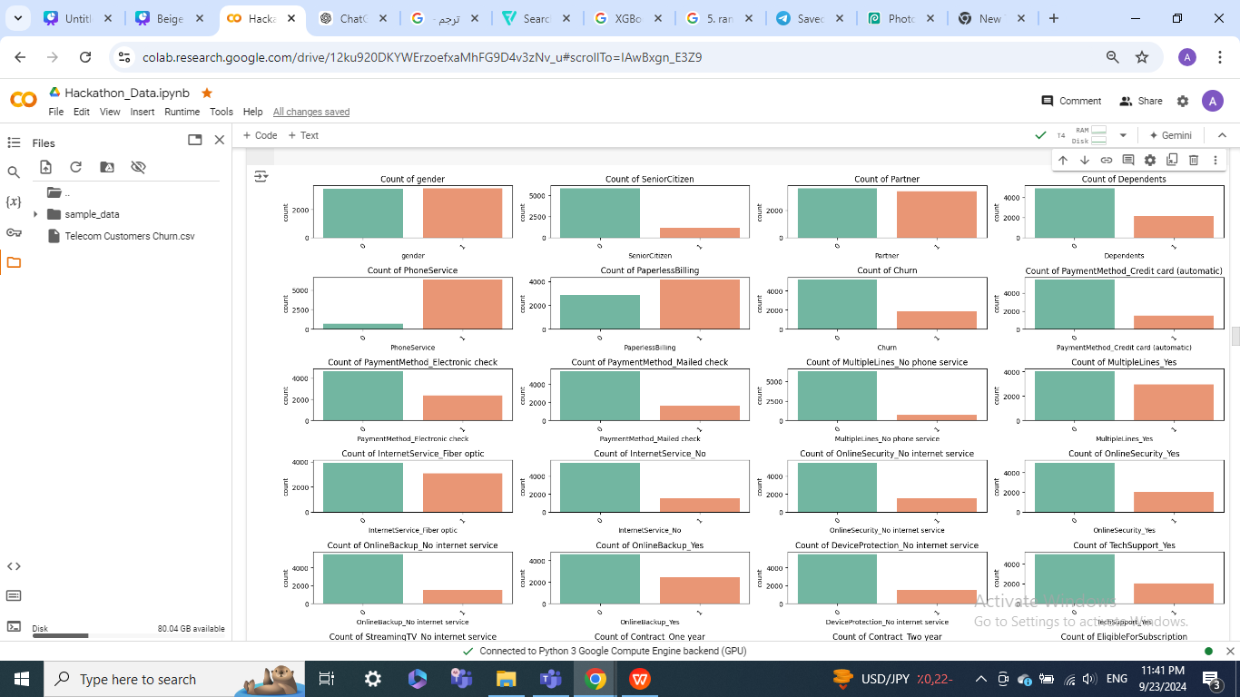
Data Exploratory analysis (EDA)
3. Categorical Analysis
Purpose: Analyze relationships among categorical variables.
Insights: Identified strong patterns, such as customers with month-to-month contracts showing higher churn rates.

Slide 16
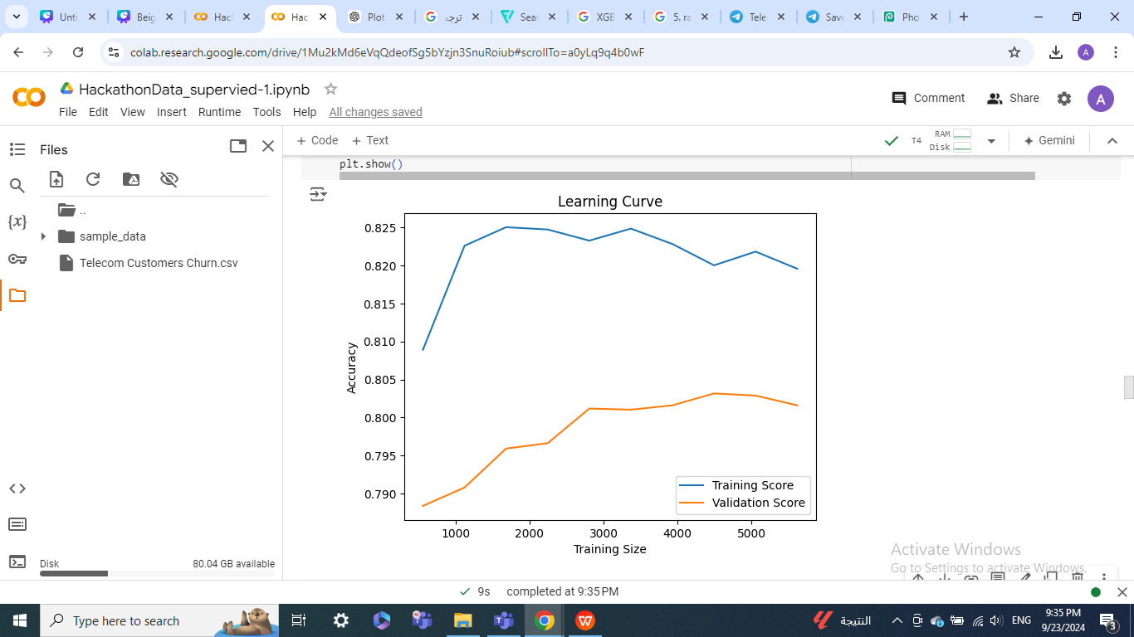
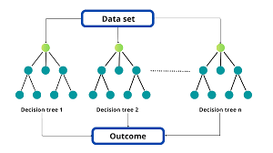
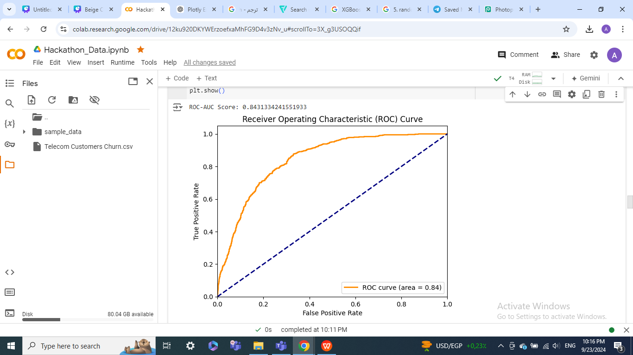
Machine Learning Models
1. RandomForestClassifier
Description: Ensemble of decision trees
Strength: Robust and reduces overfitting
Performance Metrics
Accuracy: 79%
Precision: 80%
Recall: 79%
F1 Score: 79%
ROC-AUC: 84.31%

Slide 17
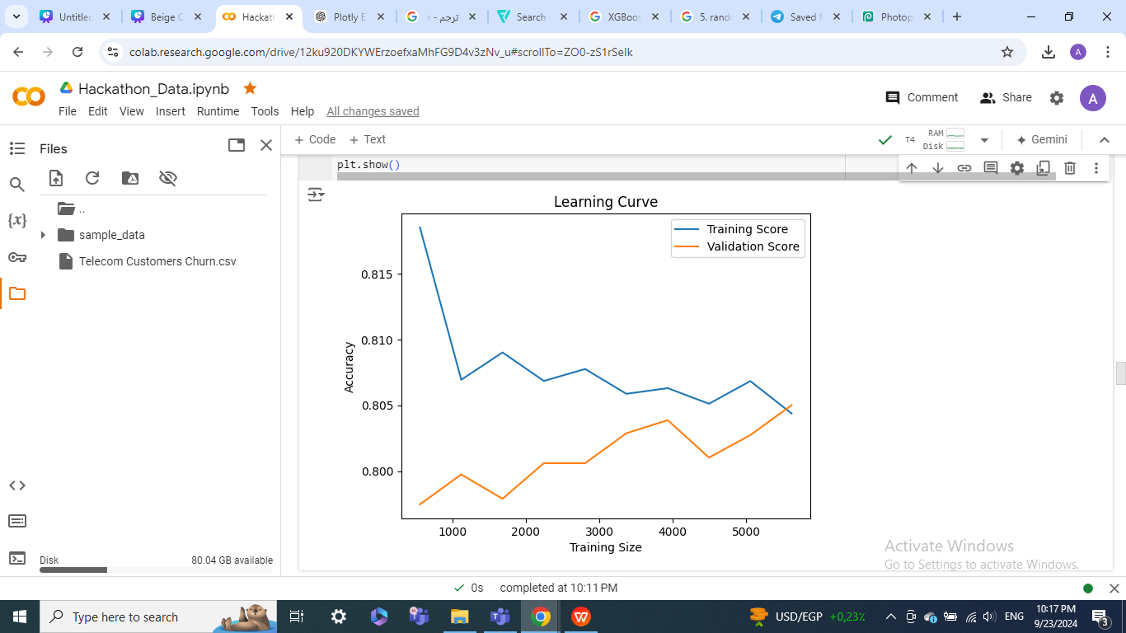
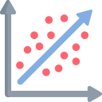
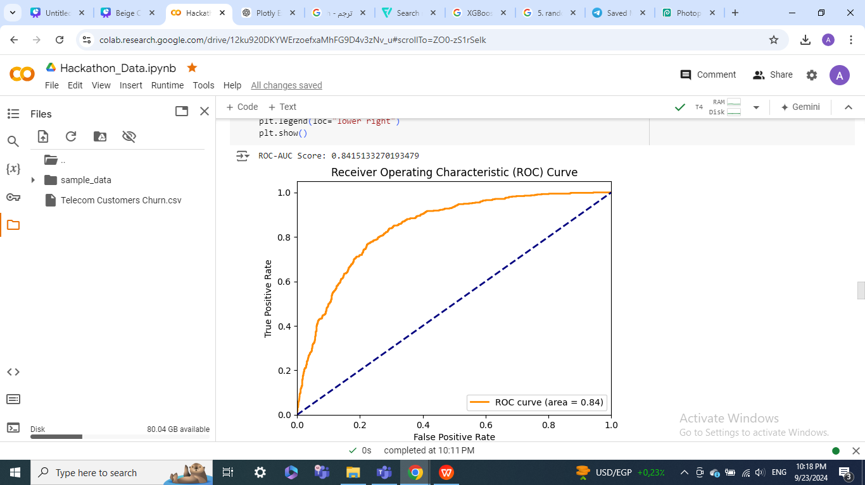
Machine Learning Models
2. Logistic Regression
Description: Used for binary classification
Strength: Simple and interpretable model.
Performance Metrics
Accuracy: 79%
Precision: 80% )
Recall: 79%
F1 Score: 79%
ROC-AUC: 84.15%

Slide 18
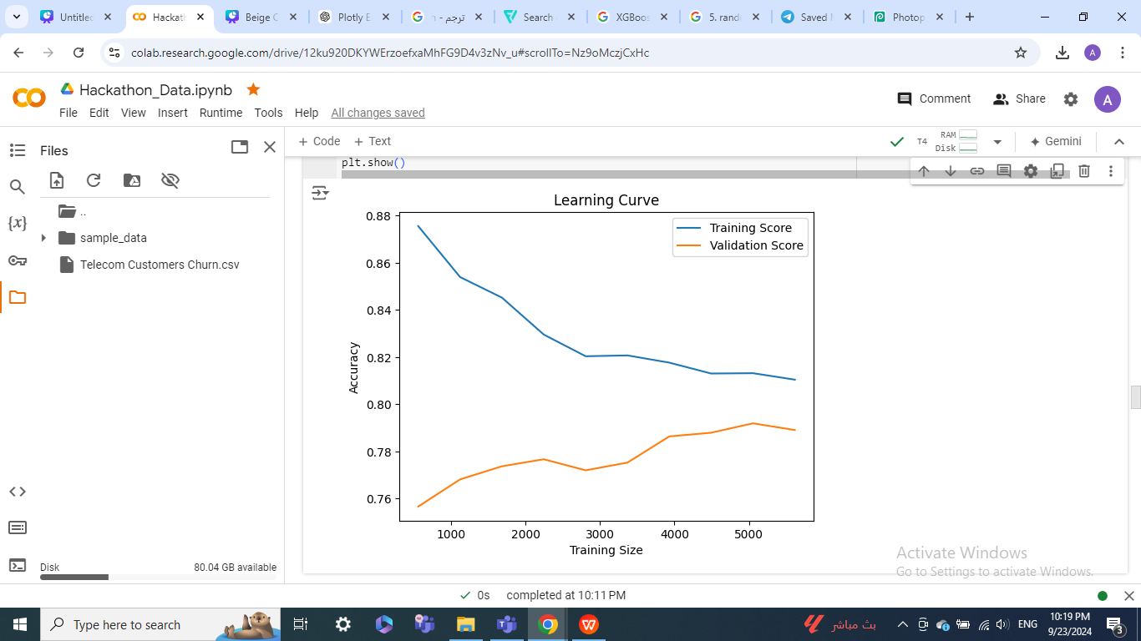
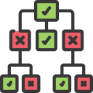
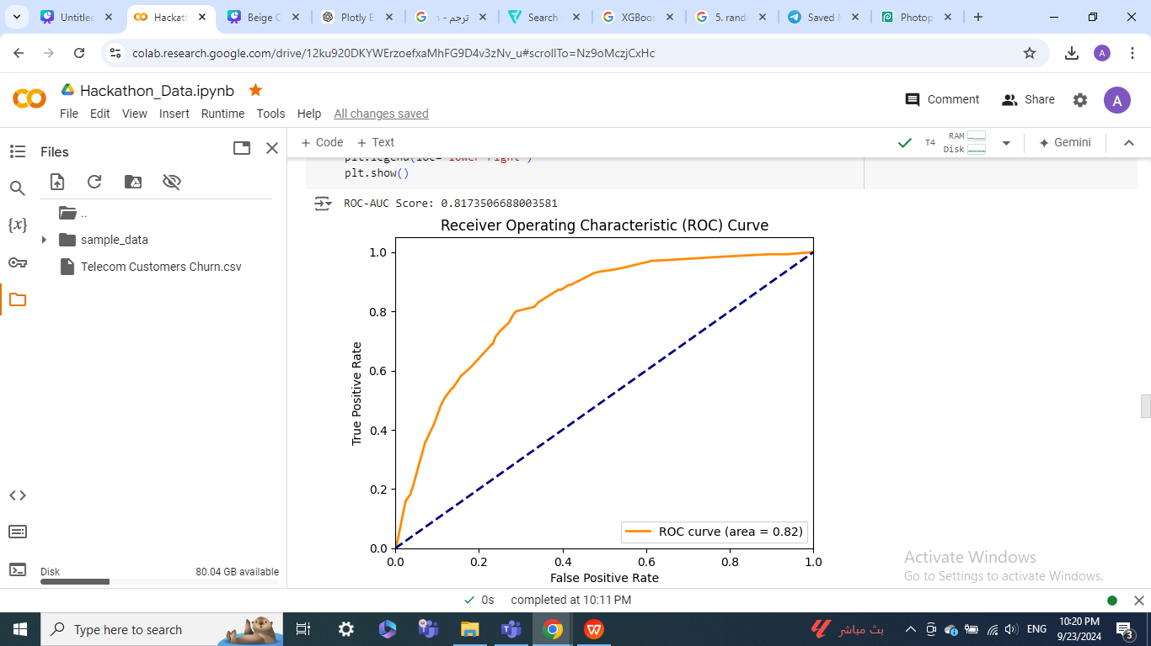
Machine Learning Models
3. Decision Tree Classifier
Description: Tree-based model for classification and regression
Strength: Easy to visualize and understand
Performance Metrics
Accuracy: 79%
Precision: 80%
Recall: 79%
F1 Score: 79%
ROC-AUC: 81.74%

Slide 19

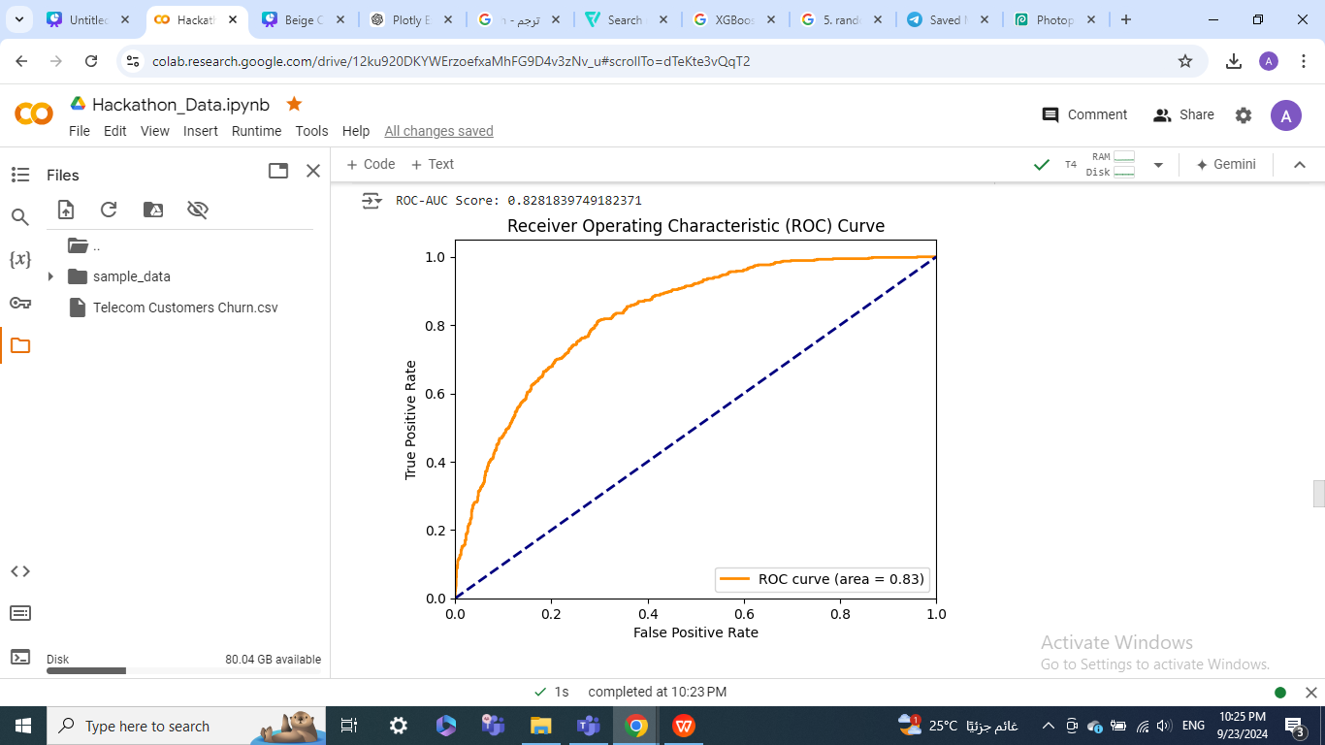
Machine Learning Models
4. XGBoost Classifier
Description: Used for binary classification
Strength: Simple and interpretable model.
Performance Metrics
Accuracy: 78%
Precision: 79%
Recall: 78%
F1 Score: 78%
ROC-AUC: 82.82%
XGBOOSt
Algorthim

Slide 20
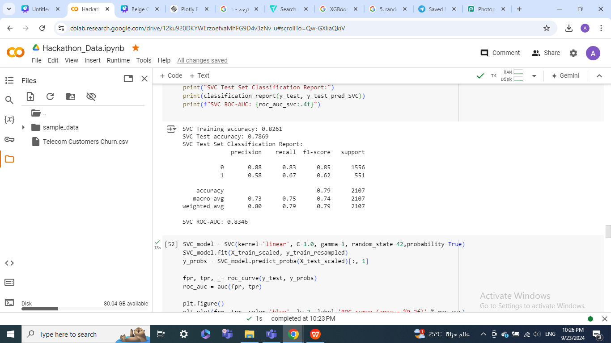
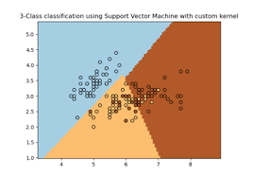
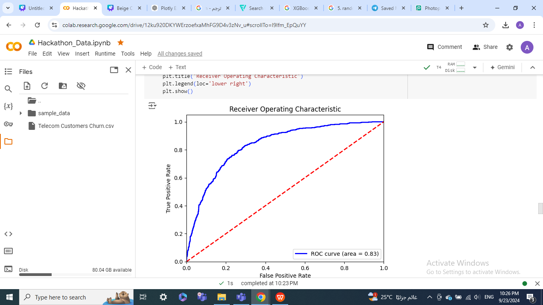
Machine Learning Models
5. SVC
Description: Effective in high-dimensional spaces
Strength: Good for non-linear boundaries
Performance Metrics
Accuracy: 79%
Precision: 80%
Recall: 79%
F1 Score: 79%
ROC-AUC: 83.46%

Slide 21
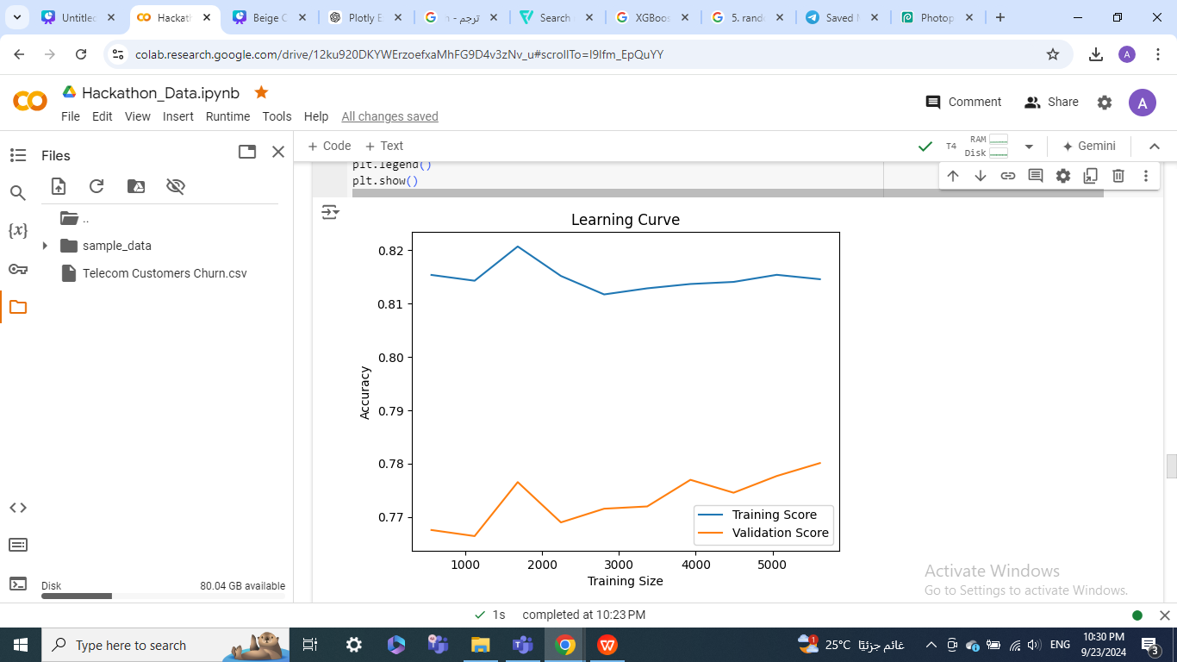
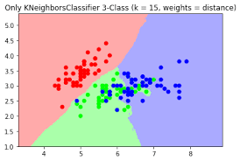
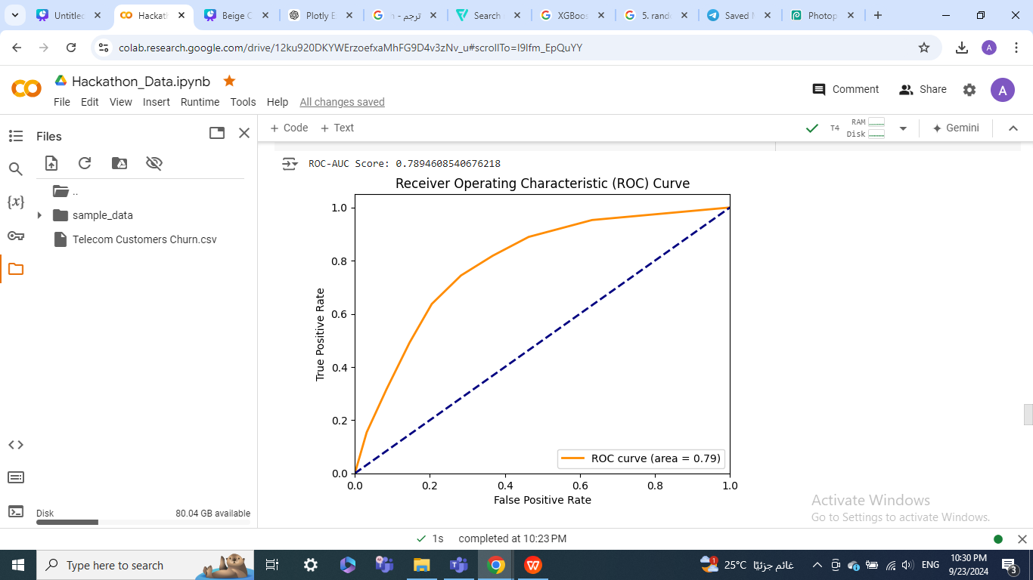
Machine Learning Models
6. KNeighborsClassifier
Description: Instance-based learning
Strength: Simple and intuitive
Performance Metrics
Accuracy: 75%
Precision: 77%
Recall: 75%
F1 Score: 76%
ROC-AUC: 78.95%

Slide 22
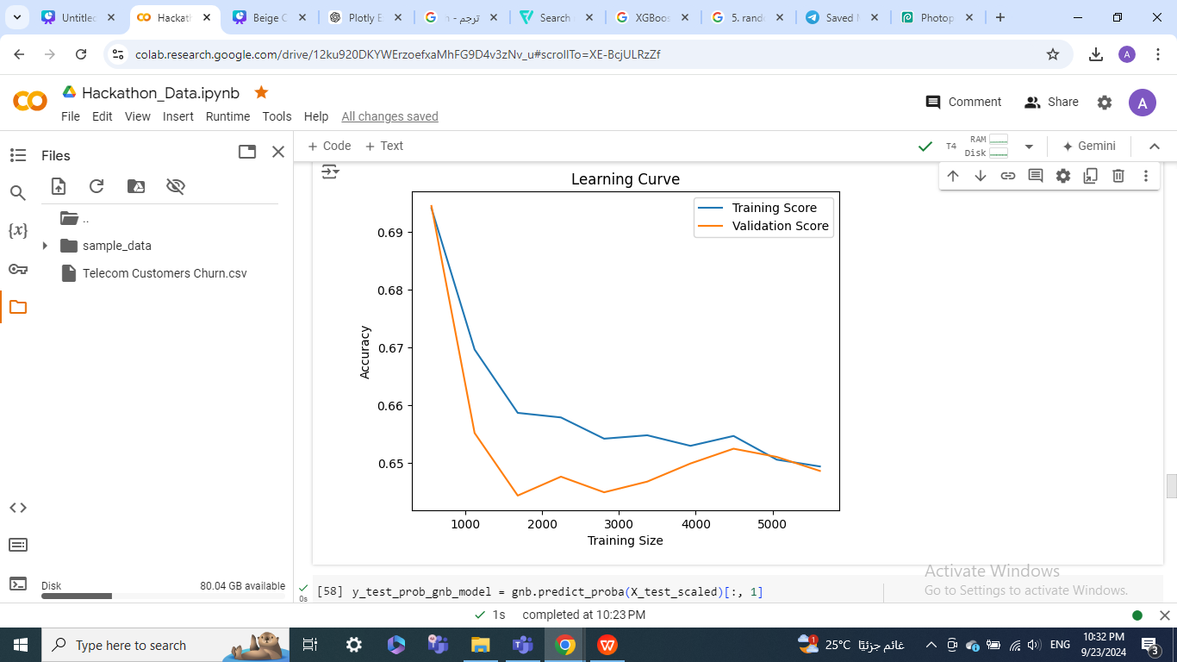
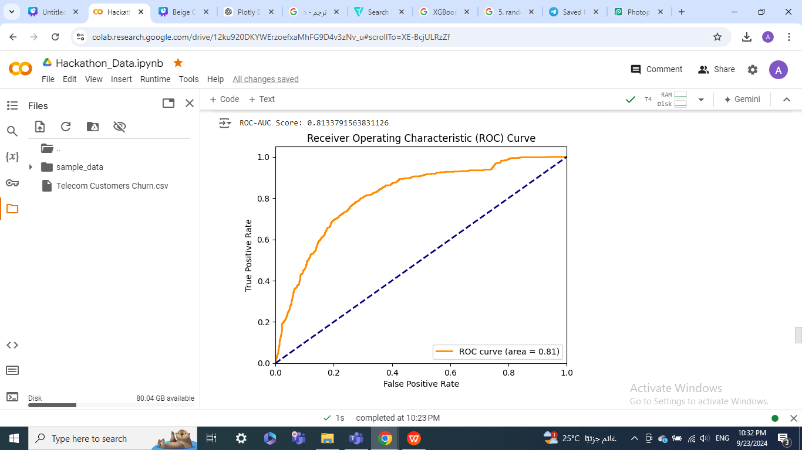
Machine Learning Models
7.GaussianNB
Description:Probabilistic model based on Bayes' theorem
Strength: Fast and efficient for large datasets
Performance Metrics
Accuracy: 69%
Precision: 80%
Recall: 69%
F1 Score: 71%
ROC-AUC: 83.46%
GaussianNB

Slide 23

Unsupervised Learning
Objective:
The goal of this project is to segment telecom customers based on their usage patterns and demographic characteristics. By grouping customers into distinct clusters, we can gain deeper insights into their behaviors, identify potential churn risks, and create targeted marketing strategies.
Key Techniques:
Clustering: We employ K-Means and Agglomerative Clustering algorithms to group customers based on their similarity.
Dimensionality Reduction: Principal Component Analysis (PCA) is used to reduce the complexity of the data and visualize the clusters in a two-dimensional space.
Performance Evaluation: The Silhouette Score is utilized to assess the quality of the clustering, ensuring that the clusters are well-defined and meaningful.

Slide 24
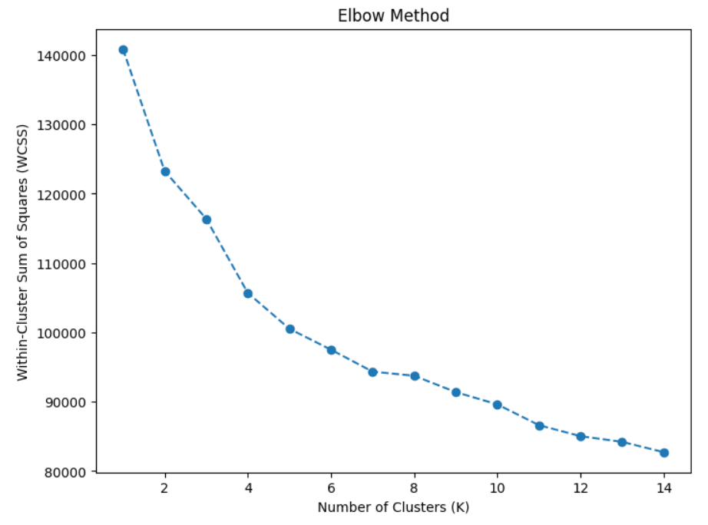
Machine Learning Models
1-K-Means Clustering
Objective: Group customers into clusters based on their behavior.
Elbow Method: Determine the optimal number of clusters (K) by plotting Within-Cluster Sum of Squares (WCSS).
Result: Selected K = 5 as optimal
Silhouette Score:
Purpose: To measure the quality of the clustering by assessing how well each data point fits within its assigned cluster and how distinct each cluster is from others.
Result:
0.13

Slide 25
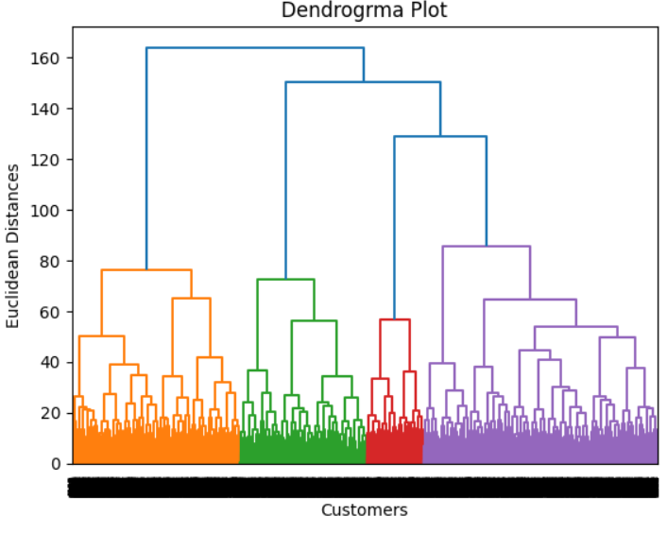
Machine Learning Models
2-Hierarchical Clustering
Objective: Compare clustering methods.
Method: Performed Agglomerative Clustering and plotted a Dendrogram to visualize cluster formation.
Silhouette Score:
0.11

Slide 26
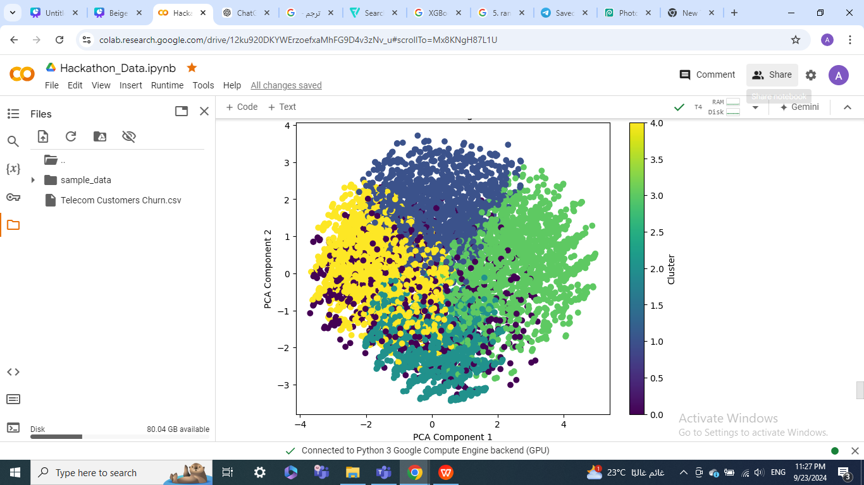
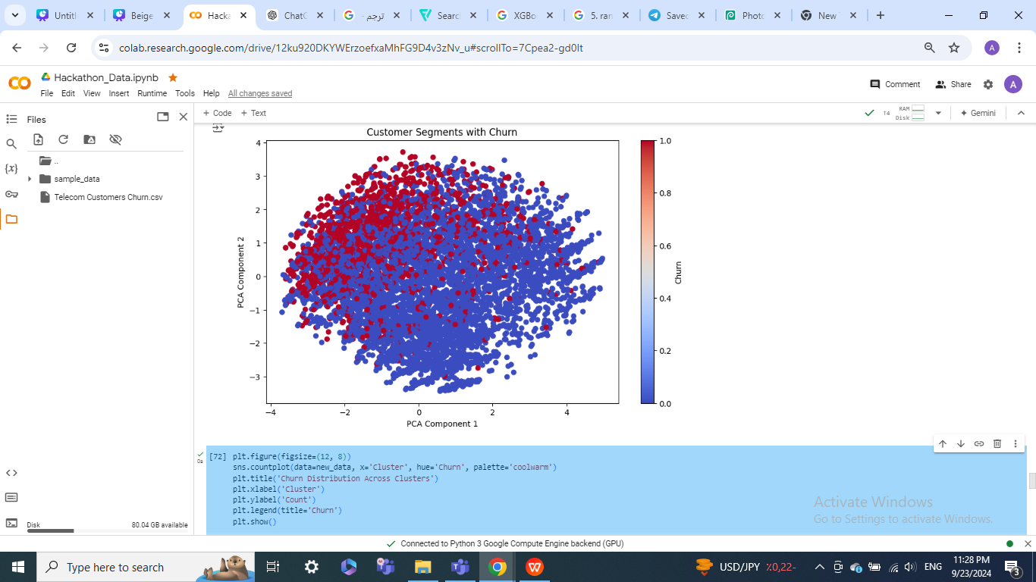
Principal Component Analysis (PCA)
1. Purpose: Reduce data dimensionality to visualize customer segments.
2. Approach:
Used PCA with 2 components to project high-dimensional data onto a 2D space.
Visualized the clusters and customer churn across principal components.
3. Visualization:
Scatter plots display customer segments and clusters based on the principal components.
Component 1 and Component 2 serve as axes, highlighting key variations in the data.
components.

Slide 27
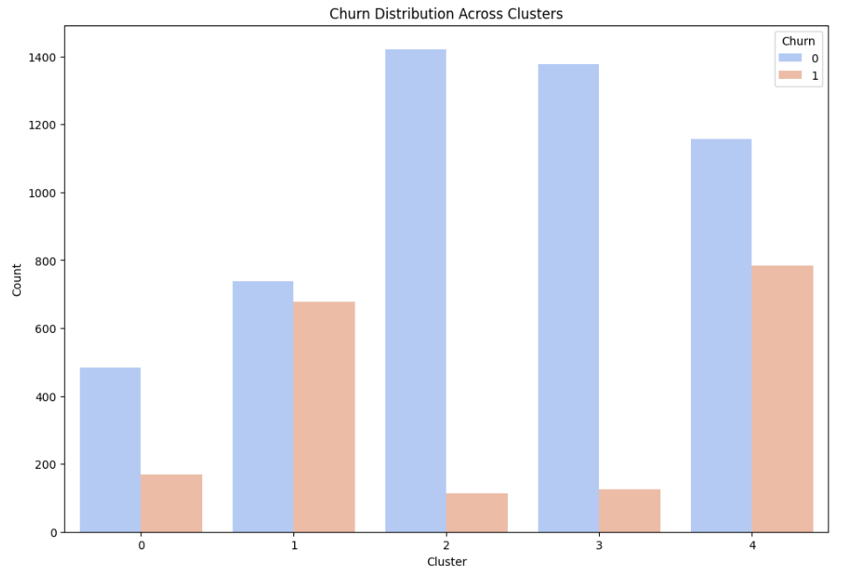
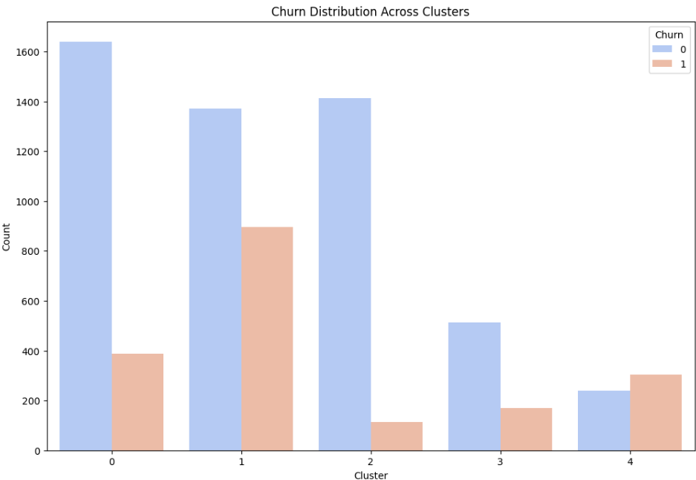
Churn Distribution Across Clusters
Insights:
Cluster Insights: By analyzing the distribution, we can identify which clusters have a higher proportion of customers who churn.
understand Churn Behavior: Analyze the distribution of churn across different customer clusters to gain insights into which clusters have higher or lower churn rates.
kmeans
Hierarchical

Slide 28
Conclusion
This project successfully analyzed customer behavior in the telecom industry, predicting churn and segmenting customers into meaningful groups. By implementing supervised learning models, we accurately identified customers likely to churn, allowing businesses to target retention efforts effectively. The unsupervised clustering revealed distinct customer segments, helping companies tailor their services and offerings

Slide 29
Thank you

